Slide 1
HWA Project

Slide 2
Introduction
Who am I?
My name is Michael King.
What have I done?
I’ve created a Web Application based on a hobby of mine that allows the end-user to apply CRUD functionality to a locally-hosted database
How have I achieved this?
I used the deliverables checklist along with the provided scope and constraints set in the given project specification document to create my web application

Slide 3
concept
Planned my project on a Kanban Board using Jira software
Decided on a layout for my front-end website
Planned to use techniques and new technologies taught to me in prior learning, implementing them into my project
Used the story points from my Jira board to decide which tasks needed to be completed in which order

Slide 4
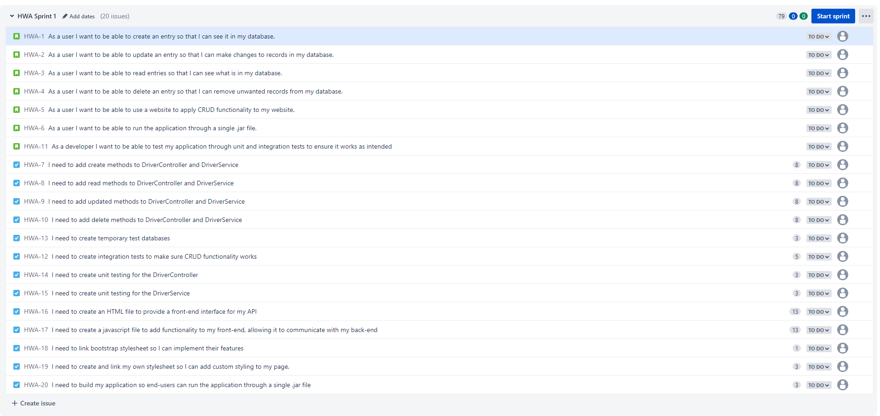
Sprint plan

Slide 5
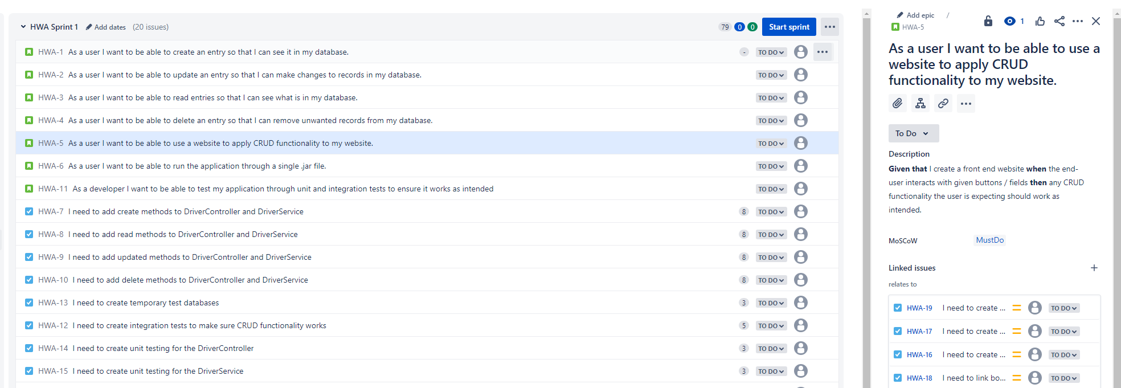
Sprint plan

Slide 6
Sprint plan
Each issue has its own acceptance criteria to describe the requirements needed to mark the given user story as complete

Slide 7
Sprint plan
Each issue also has its own priority in the form of MoSCoW methodology. In this case, this user story is a must have as it is part of the MVP

Slide 8
Sprint plan
Story points are used for time estimations – I used the Fibonacci sequence as recommended to spread out the numbers and show a clear relative sizing of story points

Slide 9
Sprint plan
Issues are broken into subtasks which I have to complete to mark the issue as completed. It also helps me break down issues into smaller chunks to help plan how I’m going to

Slide 10
Educational Journey
What have I learned for the project?
Front-End technologies:
HTML / CSS / JavaScript
Back-End technologies
SpringBoot
H2

Slide 11
Version Control
GitHub:
I used the feature-branch model to add features bit-by-bit.
Every time I’d start on a new feature, I would create a new branch off my dev branch and push to that, when I was happy with my feature I’d merge it to the dev branch.
At the end of the project I could then merge my dev branch to my main.
Doing this reduced risks of breaking pre-existing code, and also meant if I made a mistake or lost some code, I could revert to previous “commits” which is similar to a history log of my project.

Slide 12
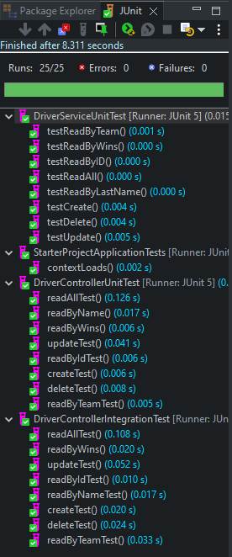
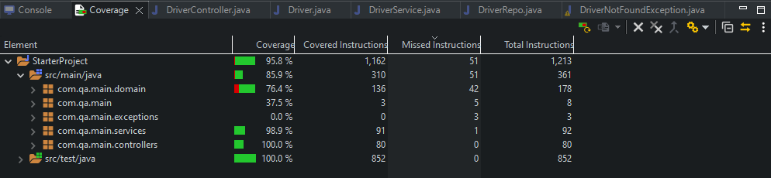
Testing
I achieved above industry standard for test coverage by getting 85.9% coverage in my main folder.

Slide 13
Demonstration

Slide 14
Sprint review
All tasks in the first sprint were completed
Nothing was left behind
What went well?
I used story points to decide on the order in which I completed tasks, and regularly referred to my Jira board to make sure I am meeting acceptance criteria and finishing all tasks before crossing off an issue.
Improvements:
I could have included more in the first sprint; maybe some extra features such as aesthetics for the webpage to make it more user friendly.

Slide 15
Conclusion
I would say this project was successful for me as I met MVP and pushed myself to work on the front-end even though I was struggling with certain aspects of it. I’ve picked up new knowledge and gained more experience working with projects in an agile way.
Future steps for this project could include extra functionality on the webpage e.g edit buttons that provide a pop-up window to update records, ways to filter the records and sort them by wins etc.

